Slide 1
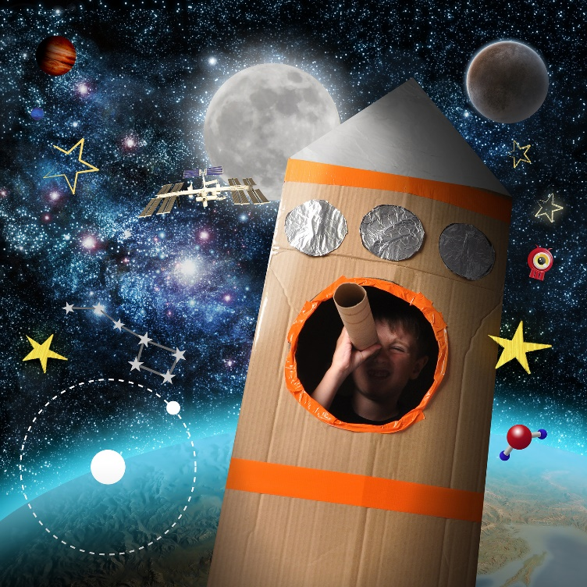
Exercise 5: KidSpace

Slide 2
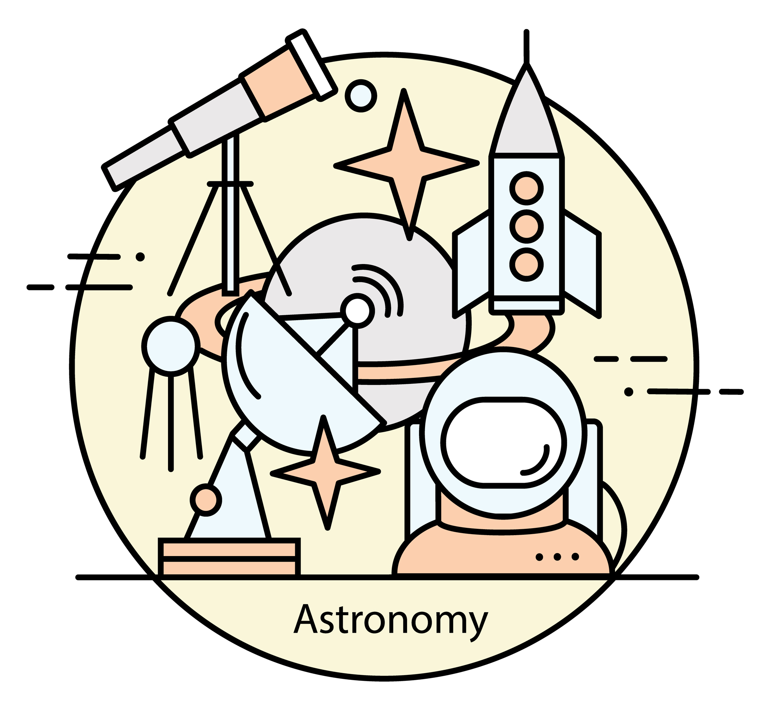
Exercise 5: KidSpace
https://github.com/topherCantrell/class-HTMLCSS/tree/master/Exercise5
The KidSpace website needs some styling!
Use the existing “index.html” and create your own CSS file to style the HTML. Add classes and IDs as needed.
Change the <div>s to modern HTML5 tags as you see fit.
https://github.com/topherCantrell/class-HTMLCSS/tree/master/Exercise5
Next add a table of “Planet Information” to the top of the main content. Use the web to find the following data to the table:
Planet Name
Mass
Time for One Orbit
Distance From Sun

